Slide 2
6Million Visually Impaired children on the planet
39 million Blind people on the planet
90% are in developing countries
Less than 10% access to education
What can we do… What is OUR reach?

Slide 3
Is the pen mightier than the sword?
Listen to one Visually Impaired (VI) boys ‘Journey of Peace’ as he seeks to do something. Its been read at the Palace of Westminster and the United Nations…what do you think of the story? (film clip below please click to play)

Slide 4
WOULD you like to join together in and support VI young people around the world?
Here are some of the ways you can help:
Decide if you want to help NOW during and immediately after this assembly!
Read the comic version ‘Journey for Peace’ as you learn about how you can help
Work with other schools to get educational resources to VI children around the world
Enter a T-Shirt competition
Join us at a music event on October 4th 2020

Slide 5
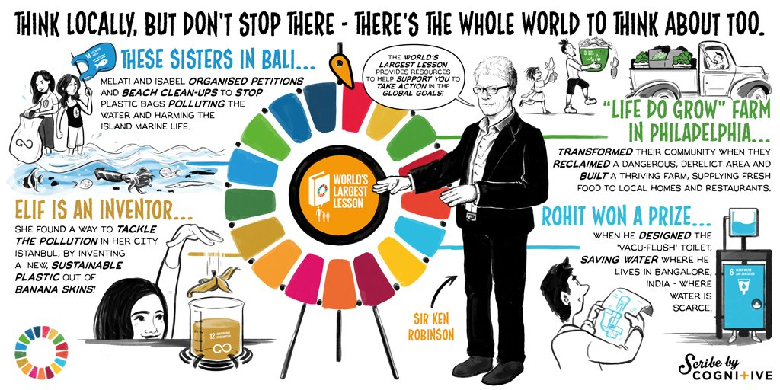
We are going to take action through the UN SDGS to support VI pupils Locally Nationally and Internationally
Our collective SDG actions are:
Goal 17 Partnerships Goals 3.4.5.8.10 health and wellbeing, quality education, gender equality , decent work and economic growth , reduced inequalities.

Slide 6
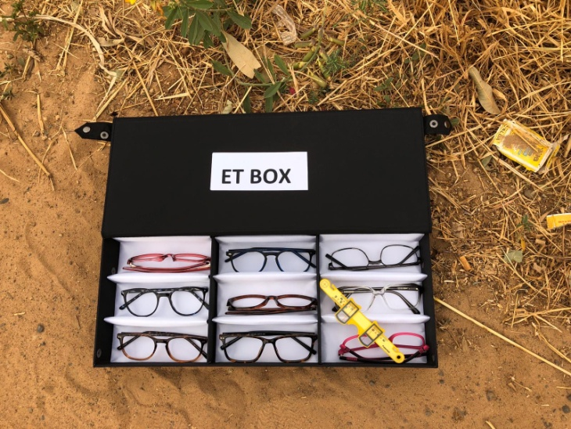
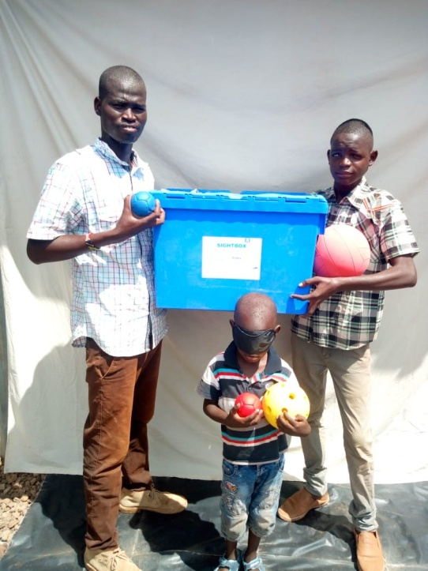
Where will your help go?
ET Box
Sightbox

Slide 7
