Slide 1
in collaboration with
Journey of Hope

Slide 2
a project by
Sustainable Schools International Network is a non-profit Community Interest Company (CIC).
Our mission is to connect special needs and mainstream schools across the world through sustainability focused projects and events.
All company income is used to fund our sustainability projects.

Slide 3
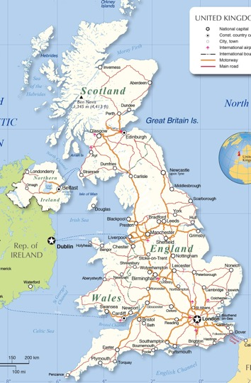
A tour of Britain’s sustainable schools, from North to South
With Visually Impaired students from St.Vincent’s School
Planned and delivered through a multi-school collaboration
Using only sustainable transport along the way
Discovering visions of a sustainable future already in action

Slide 4
19 – 26 September 2020

Slide 5
project aims
connect
schools
act
together
inspire
others

Slide 6
“Life gives us our own journeys and challenges, but we are all ultimately on the same road when it comes to the time we have on this world. Never has it been more important to help each other on our connected journeys and show the children of the future where mistakes in the past have left 'potholes' for us to stumble on. Such potholes include the damage already done to nature. We can all do our 'bit' to address the balance and leave a cleaner better world for future generations. The Journey of Hope highlights the little things we can all do, and together, which all add up to making something bigger happen.”
Dr. John Patterson
Principal, St. Vincent’s School for Sensory Impairment

Slide 7
Educational partners
Liverpool John Moores University is a modern, pioneering, civic university committed to delivering solutions to the challenges of the 21st century through world-class research, education and innovation.
We do this by integrating education for sustainable development in both research and academic programmes and by operating our university in the most sustainable and environmentally responsible way possible. We strive to create and sustain a community that is aware of its social, economic and environmental impact, resilient, healthy and happy.
CAT is an educational charity dedicated to researching and communicating positive solutions for environmental change.
We speak to government and campaigners about policies that would help create a zero carbon Britain; we train students in all aspects of sustainability; we help schoolchildren to understand the importance of action on climate change; and we give advice to householders on what they can do in their own homes.

Slide 8
Project steps
September / Week 1
September / Week 2
September / Week 3
September / Week 4
VISION
IDEAS
ACTION
REPORT
Project and SDGs introduction
Communication with partner school
Looking to the future activities
Create newspaper from year 2050
Students create ideas for progressing SDGs
Submit best ideas to expert panel
Best ideas receive Journey of Hope Awards
Work with partner to host sustainability challenge on 25th September
Attend virtual summit with all schools and expert speakers
Submit a student written article for Journey of Hope magazine
Submit report for Journey of Hope Impact Report

Slide 9
Sign-up and receive
Classroom Sustainability Learning Resource pack – developed with Liverpool John Moores University
Partner school to work with on the project
Entry into the Journey of Hope Awards
Zero Carbon Britain online workshop from the Centre for Alternative Technology
Project guidance pack
Segment in our movie of the Journey of Hope

Slide 10
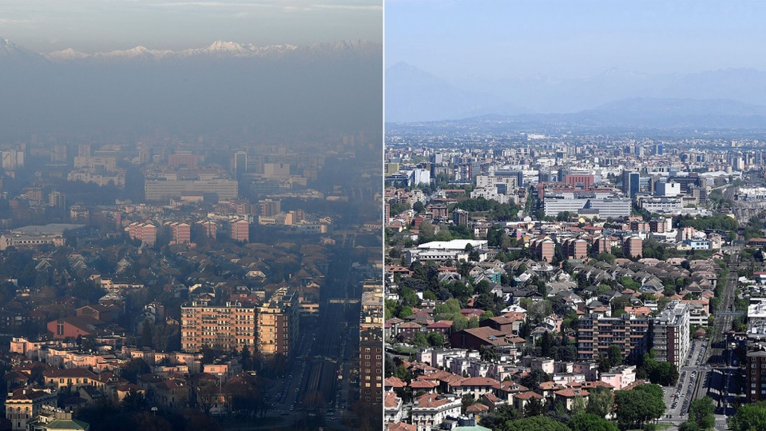
our actions matter

Slide 11
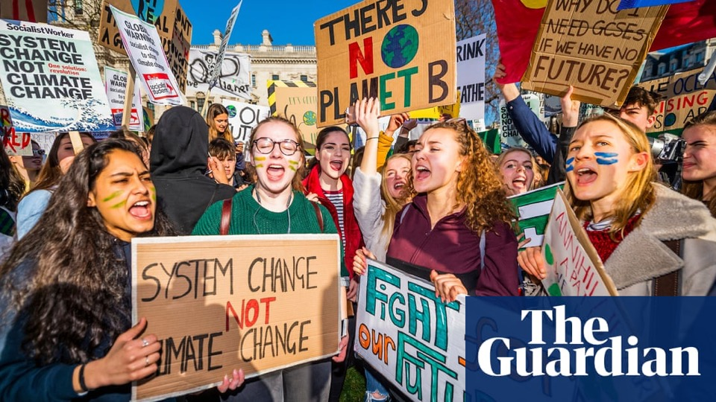
purpose for the future

Slide 12
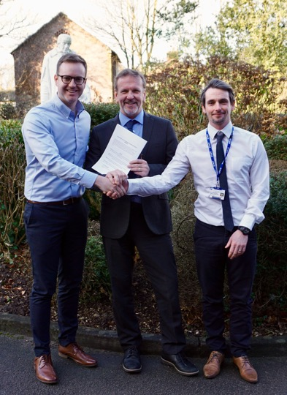

Slide 13
we believe that…
Schools can be world leaders in sustainability
Collaboration is the best way to tackle issues
Students should leave school as eco-conscious citizens
Schools can be the testbed of future possibilities

Slide 14
Join our journey
all schools welcome, no cost.
johnp@stvin.com
davids@stvin.com
david@sustainable-schools-network.org

