Slide 1
UK Schools Sustainability Network
Hosted by Global Action Plan
Toma, UKSSN COP26 & London Schools Eco Network rep
@UKSchoolsSusty
getintouch@ukssn.org.uk

Slide 2
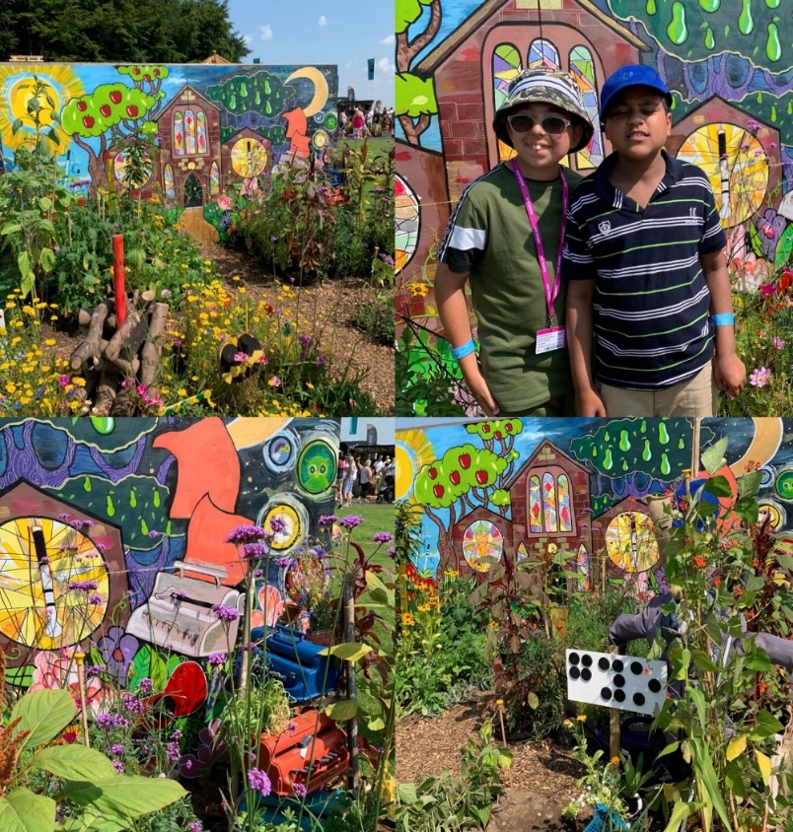
Our aims
Connecting pupils of all backgrounds
Bringing teachers together
Regional, national & global collaboration
Sharing ideas and resources
Influencing peers & leaders together
St Vincent’s Specialist School for Sensory Impairment, Liverpool Founder of Mersey Region Schools Sustainability Network

Slide 3
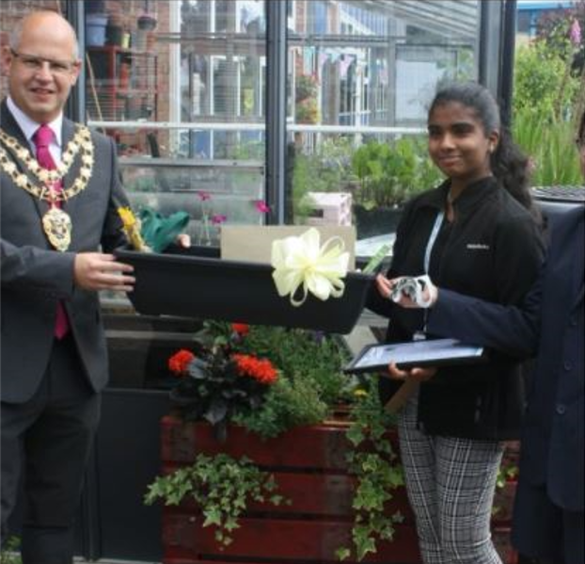
Our reach
12 regional networks across UK and Ireland
UK ‘network of networks’
UK and regional staff groups
Partnerships with NGOs and community groups
International twinning
Aylesbury High, Buckinghamshire
Aylesbury High, Buckinghamshire Founder of Bucks Schools Sustainability Network

Slide 4
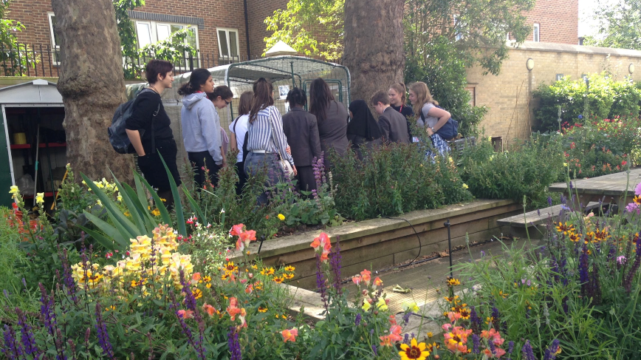
Schools and nature
School gardening and food growing
Rewilding, wildflower meadows, tree planting
Benefits to physical and mental health
Leadership and social skills
Hammersmith Academy, London Co-founder of London Schools Eco Network

